Slide 1
Do Now 9/13
Monday
In your composition books, describe the way Sumerian cities are laid out.

Slide 2
Last week’sVocabulary
Mesopotamia Euphrates Tigris Scribe Fertile Crescent Irrigation silt metallurgy slave labor plow | Area between the two rivers Southern river defining Mesopotamia Northern river defining Mesopotamia A person who reads and writes for a living Area of farmable land curving from Egypt to the Persian gulf. To control the flow of water to crops Fine soil carried by a river The art of metalwork and smelting Forced work for no pay Tool used to till soil.

Slide 3
New Vocabulary
Sumer city-state Monarchy empire polytheism Deities Cuneiform Ziggurats Epic Hammurabi | 1st True city. Large settlement which controls the area around it and is independent of any other control. Government led by a king Multiple city or culture political unit. Belief in more than one god. Supernatural entities in charge of some aspect of life (gods) Written language made with a reed in wet clay. Large pyramid shaped building in the center of a Sumerian city. Longform story which tells a moral story. Sumerian ruler who was first to write down the laws of his city.

Slide 4
Standard
6.08 Analyze how advancements in agriculture in Sumer led to economic growth, expansion of trade and transportation, and the emergence of independent city-states.

Slide 6
Class-kick Codes: Breland
2nd | TPI TI3
3rd | 4DA TM9
6th | SED G6K
7th | I67 PA7

Slide 7
Text for 6.08: Sumer
Whenever the Sumerian civilization was first established in the region, by 3600 BCE they had invented the wheel, writing, the sail boat, agricultural processes such as irrigation, and the concept of the city (though China and India also lay claim to `the first cities’ in the world). It is generally accepted that the first cities in the world rose in Sumer… The city of Uruk is held to be the first true city in the world.
With the establishment of the cities of Sumer, their history unfolds from approximately 5000 BCE to 1750 BCE when “the Sumerians ceased to exist as a people” (Kramer) after Sumer was invaded by the Elamites and Amorites. After the Ubaid Period (c. 5000-4100 BCE) came the Uruk Period (4100-2900 BCE) in which cities began to emerge across the landscape and the city of Uruk rose in prominence….
1. Identify and describe two inventions from Ancient Mesopotamia.
2. What is Sumer’s claim to fame?
3. Infer: Which civilization is Sumer a part of?

Slide 8
Trade was firmly established with foreign lands at this time and writing evolved from pictograms to cuneiform script. It is thought that trade was the main motivator in the development of writing as there now had to be some means for accurate, long-distance, communication between the merchants of Sumer and their agents abroad. The kingship also arose at this time and the city-states of Sumer came to be ruled by a single monarch who was assisted by a council of elders (which included both men and women).
The kings of Ur, Ur-Nammu (r. 2047-2030 BCE) and Shulgi (r.2029-1982 BCE)), set cultural advancement as the goal of their administrations and maintained a peace which allowed for art and technology to flourish. Whether invented before or during the Ur III Period, the tools, concepts, and technological innovations in place during the Third Dynasty of Ur solidified the Sumerian’s place in history as the creators of civilization as we know it.
4. What invention came as a result of trade?
5. What type of government did Sumer have?

Slide 9
In Samuel Noah Kramer’s book History Begins at Sumer he lists 39 “firsts’ in history from the region among which are the first schools, the first proverbs and sayings, the first love song, the first aquarium, the first legal precedents in court cases, the first funeral chants… and [the] first moral ideas. The Sumerians also essentially invented time in that their system of counting (a system based on the number 60) created the 60-second minute and the 60-minute hour. They also divided the night and day into periods of 12 hours, set a limit on a `work day’ with a time for beginning and ending, and established the concept of `days off’ for holidays. The historian Bertman writes, “The hand of Mesopotamia still determines the hourly length of the traditional workday and even the length of our electronic entertainment (half-hour or hour TV shows) when our workday has stopped” (334). Bertman further notes that the modern day practice of checking one’s horoscope comes from ancient Sumer and that the astrological signs one is born under were first noted and named by the ancient Mesopotamians.
6. This section lists many famous firsts that were accomplished in Sumer. Choose three that you think are the most important and explain why you chose those firsts as being historically significant.

Slide 10
Exit ticket
Monday
In your composition books, answer the following
“how did trade affect Sumerian society?”

Slide 11
Do Now 9/14
Tuesday
In your composition books, explain what you think is the most important advancement of Sumer.

Slide 12
New Vocabulary
Sumer city-state Monarchy empire polytheism Deities Cuneiform Ziggurats Epic Hammurabi | 1st True city. Large settlement which controls the area around it and is independent of any other control. Government led by a king Multiple city or culture political unit. Belief in more than one god. Supernatural entities in charge of some aspect of life (gods) Written language made with a reed in wet clay. Large pyramid shaped building in the center of a Sumerian city. Longform story which tells a moral story. Sumerian ruler who was first to write down the laws of his city.

Slide 13
Standard
6.09 Explain the basic concepts of monarchy and empire, and identify Mesopotamia as the regional location of the world’s first empire.

Slide 15
Video:
https://www.youtube.com/watch?v=x44xjFoctMw&list=PLTy20U1mGXrXQiRHxFmcFFgCDj2W_zB5w&index=6

Slide 16
Class-kick Codes: Breland
2nd | TPI TI3
3rd | 4DA TM9
6th | SED G6K
7th | I67 PA7

Slide 17
Text for 6.09: Sargon of Akkad
The Akkadian Empire was the first political entity to make extensive and efficient use of bureaucracy and administration on a large scale and set the standard for future rulers and kingdoms. [Sargon’s] story was long known throughout Mesopotamia where, in time, he came to be considered the greatest man who had ever lived...The historian Paul Kriwaczek sums up the impact Sargon had on later generations in Mesopotamia, writing, "for at least 1,500 years after his death, Sargon the Great, founder of the Akkadian Empire, was regarded as a semi-sacred figure, the patron saint of all subsequent empires in the Mesopotamian realm" (111).
…When Sargon overthrew Lugalzagesi and seized power he gained an already united kingdom which he could use to advantage in military campaigns to establish the first empire over all of Mesopotamia. He may have been helped in this by his own legend which established his humble backgrounds. …class distinctions in the Sumerian cities had led to a growing resentment by the lower class for the upper elite. The wealthiest citizens were able to take as much land as they could hold and the lower classes routinely felt disenfranchised. Sargon's tale of his humble beginnings as a gardener would have appealed to the large numbers of working-class Sumerians who may have seen him as a liberator and reformer. Directly after his rise to power, however, the city-states and their ruling elite hardly accepted Sargon with grace and submission; they rebelled against their new ruler, and forced him to prove his legitimacy as king through military might.
Who was Sargon? Is he historically significant? Why?
Describe the conflict between lower and upper classes in Ancient Mesopotamia in your own words.
What occupation did Sargon have before he became a king?

Slide 18
After conquering Sumer, he either built a new city or renovated an older one, Akkad on the banks of the Euphrates River. This was a complete break with precedent in that, previously, the king of an existing city conquered another for the glory of the home city and the resources which would now be available. Sargon, on the other hand, conquered for no city, only for himself and, once he had control of the area, then built his own city to enjoy the benefits of conquest. Not content with what he had accomplished thus far, he set out again on campaign.
The stability provided by this empire gave rise to the construction of roads, improved irrigation, a wider sphere of influence in trade, as well as developments in arts and sciences. The Akkadian Empire created the first postal system where clay tablets inscribed in cuneiform Akkadian script were wrapped in outer clay envelopes marked with the name and address of the recipient and the seal of the sender. These letters could not be opened except by the person they were intended for because there was no way to open the clay envelope save by breaking it, thus ensuring privacy in correspondence. Sargon also standardized weights and measures for use in trade and daily commerce, initiated a system of taxation which was fair to all social classes, and engaged in numerous building projects such as the restoration of Babylon. He also created, trained, and equipped a full-time army…where, as an inscription reads, 5400 soldiers "ate bread daily" with the king.
Even with these improvements to the lives of the citizens of Mesopotamia, the people still rebelled against Akkadian rule… As the centuries passed, however, whatever difficulties they had with Sargon's rule were forgotten and all that was remembered were his heroic feats and the `golden age' of the Akkadians.
What city-state is Sargon from?
How were Sargon’s actions different from those of the kings of other Mesopotamian city-states?
Describe 2-3 accomplishments of the Akkadian Empire.

Slide 19
Exit ticket
Tuesday
In your composition books, explain the difference between a city-state and an empire.

Slide 20
Do Now 9/15
Wednesday
In your composition books, explain who Sargon was and why he was important.

Slide 21
New Vocabulary
Sumer city-state Monarchy empire polytheism Deities Cuneiform Ziggurats Epic Hammurabi | 1st True city. Large settlement which controls the area around it and is independent of any other control. Government led by a king Multiple city or culture political unit. Belief in more than one god. Supernatural entities in charge of some aspect of life (gods) Written language made with a reed in wet clay. Large pyramid shaped building in the center of a Sumerian city. Longform story which tells a moral story. Sumerian ruler who was first to write down the laws of his city.

Slide 22
Standard
6.10 Explain the concept of polytheism and its presence in Mesopotamia, with respect to beliefs about the relationship of deities to the natural world and their importance in everyday life.

Slide 24
Class-kick Codes: Breland
2nd | TPI TI3
3rd | 4DA TM9
6th | SED G6K
7th | I67 PA7

Slide 25
Text for 6.10: Religion in the Ancient World
Instructions: Read the text and answer the questions:
As with many cultural advancements and inventions, the 'cradle of civilization' Mesopotamia has been cited as the birthplace of religion. When religion developed in Mesopotamia is unknown, but the first written records of religious practice date to c. 3500 BCE from Sumer. Mesopotamian religious beliefs held that human beings were co-workers with the gods and labored with them and for them to hold back the forces of chaos which had been checked by the supreme deities [gods] at the beginning of time. Order was created out of chaos by the gods and one of the most popular myths illustrating this principle told of the great god Marduk who defeated Tiamat and the forces of chaos to create the world. Historian D. Brendan Nagle writes:
Despite the gods' apparent victory, there was no guarantee that the forces of chaos might not recover their strength and overturn the orderly creation of the gods. Gods and humans alike were involved in the perpetual struggle to restrain the powers of chaos, and they each had their own role to play in this dramatic battle. The responsibility of the dwellers of Mesopotamian cities was to provide the gods with everything they needed to run the world. (11)
1. According to the text in the first paragraph, what was the relationship between gods and humans like in the Ancient Mesopotamian religion?
2. According to the text in the second paragraph, what could you add to your answer above?

Slide 26
Humans were created, in fact, for this very purpose: to work with and for the gods toward a mutually beneficial end. The claim of some historians that the Mesopotamians were slaves to their gods is [not correct] because it is quite clear that the people understood their position as co-workers. The gods repaid humans for their service by taking care of their daily needs in life and maintaining the world in which they lived. These gods intimately knew the needs of the people because they were not distant entities who lived in the heavens but dwelt in homes on earth built for them by their people; these homes were the temples which were raised in every Mesopotamian city.
3. According to the text, how important were the Mesopotamians gods to the daily life off Ancient Mesopotamians? Why?

Slide 27
Temple complexes, dominated by the towering ziggurat, were considered the literal homes of the gods and their statues were fed, bathed, and clothed daily as the priests and priestesses cared for them as one would a king or queen. In the case of Marduk, for example, his statue was carried out of his temple during the festival honoring him and through the city of Babylon so that he could appreciate its beauty while enjoying the fresh air and sunshine.
The temples were the center of the city's life throughout Mesopotamian history from the Akkadian Empire (c. 2334-2150 BCE) to the Assyrian (c. 1813-612 BCE) and afterwards. The temple served in multiple capacities: the clergy dispensed grain and surplus goods to the poor, counseled those in need, provided medical services, and sponsored the grand festivals which honored the gods. Although the gods took great care of humans while they lived, the Mesopotamian afterlife was a dreary underworld, located beneath the far mountains, where souls drank stale water from puddles and ate dust for eternity in the 'land of no return.'
4. Identify and describe two important roles that temples played in Mesopotamian cities.
5. Did Mesopotamians belief in an afterlife? If so, describe it.

Slide 28
Exit ticket
Wednesday
In your composition books, answer the following
“What did Sumerians think happened after death?”

Slide 29
Do Now 9/16
Thursday
What roles did temples play in ancient Mesopotamian society?

Slide 30
New Vocabulary
Sumer city-state Monarchy empire polytheism Deities Cuneiform Ziggurats Epic Hammurabi | 1st True city. Large settlement which controls the area around it and is independent of any other control. Government led by a king Multiple city or culture political unit. Belief in more than one god. Supernatural entities in charge of some aspect of life (gods) Written language made with a reed in wet clay. Large pyramid shaped building in the center of a Sumerian city. Longform story which tells a moral story. Sumerian ruler who was first to write down the laws of his city.

Slide 31
Video:
https://www.youtube.com/watch?v=sZJj6DwCqSU

Slide 32
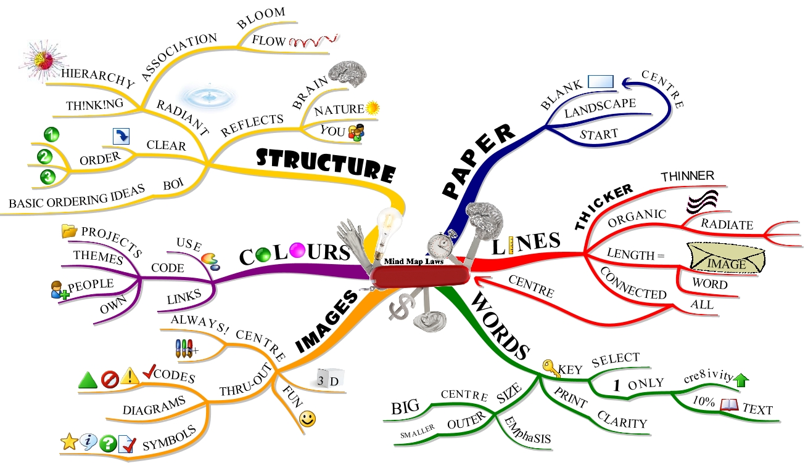

Slide 33
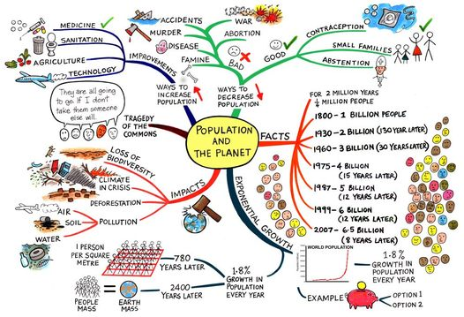

Slide 34
Brainstorm on your own paper any information about ancient Sumerians you can think of…. 10 min.

Slide 35
Now lets create one as a class. Use the information from your map to populate ours….

Slide 36
Exit ticket
Thursday
Describe how a concept map can be used to study.

Slide 37
Do Now 9/18
Friday
Write down as many of your Vocab words as you can think of (This week and last) No peeking!

Slide 38
Mastery Connect Quiz
2nd
3rd
6th
7th

