Slide 1

Welcome to
6th Grade at Highland Oaks Middle School

Slide 2

Your 6th Grade Teachers
Team 6A
Team 6B
Ms. Werner ELA
Mrs. Boyce Math
Ms. Springfield Science
Mr. Seaton Social Studies
Ms. Weiser Co-Teacher
Ms. Orr ELA
Ms. Yarn Math
Mrs. Odom Science
Mr. Breland Social Studies

Slide 3
6th Grade Warm-up
Monday, August 9, 2021
Please keep all materials in your backpack. Place backpack under desk.
Please complete the interest inventory that is located on your desk.
Please sit quietly when you are finished.

Slide 4
Today’s Agenda:
August 9, 2021
Welcome/Interest Inventory/Introductions
Hallways Procedures and Rules
Restroom Procedures and Rules
Cafeteria Procedures and Rules
School Vision and Expectations
Health & Safety Procedures and Drills
Morning/Afternoon Procedures
Practice of Dismissal
Dismissal

Slide 5


Slide 6
Restroom Procedures
Teacher will line all students up prior to leaving the room.
Students will exit quietly into the hall.
Students not using the restroom will line up in the return line.
Two students will enter the restroom at one time.
When exiting, students will wash their hands and get in the return line.
Teacher will escort students back to the classroom.

Slide 7
Restroom Rules
Students will remain quiet the entire time of the break.
Students will refrain from horse playing in restroom and the hall.
Students will refrain from vandalism or defacing property.
Students will pump soap dispenser lightly one time for soap.
Students will press paper towel dispenser latch lightly three times for paper towels.
Students will make sure to throw their used paper towel in the garbage.
Students will check to make sure the restroom is clean for the next class.

Slide 8

Hallway Procedures
Hallways are a no talking zone when transitioning.
We transition in the hallway by walking around on the maroon.
Keep your feet on the maroon, but next to a blue circle for social distancing purposes.
Move through the hallways in an orderly and quiet manner at all times.
Always keep your hands and feet to yourself.
You should be looking at the back of the person’s head in front of you.
If you need to tie your shoes, step out of the line onto the white.
If you see someone you know in the hallway, you may do a little wave but no shout outs to other students or adults.

Slide 9
Cafeteria Procedures and Rules
Follow Hallway procedures to transition to cafeteria.
Go directly to your assigned serving line (everyone must get a lunch).
Return to your assigned table.
Remain seated until you are dismissed.
Tray return
  Dump tray and place it on table before lining up.
  Teacher will assign one person to take all trays to the window.
Keep voices down.
Use good manners.
Open drinks and food CANNOT be taken out of the cafeteria.
Sharable sizes of food will not be allowed in the cafeteria.
Be polite and cooperative with cafeteria staff and monitors.

Slide 10





Mission
Highland Oaks Middle Schools mission is to equip
students with necessary skills to excel academically,
socially, emotionally, and physically in order to set them
on a path to be college and career ready.

Slide 11




Vision
Highland Oaks Middle School will be a place where all
stakeholders are committed to developing the whole
child through rigorous curricula in a safe and nurturing
environment that will prepare students to become
productive citizens and future leaders.

Slide 12















School expectations/
student core actions
All students will do his/her part in creating and maintaining
a learning environment that allow all students to move
beyond their current performance levels by:
1.
Being Respectful
2.
Being Ready
3.
Being Responsible
4.
Being Resourceful
5.
Being Reliable
Revised 9/17

Slide 13
Fire Drill
In case of fire or other emergency, the signal to evacuate the building will be a continuous sounding of the fire alarm.
You will exit the building without talking.
Leave the building quietly and quickly.
Practice drills will be held during the year. Treat each drill as if it were the real thing.

Slide 14
Tornado Drill
When the signal for a tornado is given, everyone will go to his/her assigned area. Each teacher will instruct you regarding specific procedure.
Put head down facing the wall in the hallway.
Put your hands on top of your head.
Remain calm.
Do not talk.

Slide 15
Black Hawk Down
Lockdown Drill
Move quickly and quietly to the corner of the room and sit still with no talking.
Move away for the door and window so that no one can see you.
Our blinds must be closed and our door will be locked.

Slide 16
Earthquake Drill
Students should immediately get under a desk or chair to protect their heads.
Students should hold on to the desk and chair until told that it is safe to get up.

Slide 17

Arrival
The doors will be open for students at 6:45.
Go to the cafeteria for breakfast as soon as you arrive. Do not stop by the classroom first. Breakfast is free to everyone!
If you don’t eat breakfast, report to gym to wait for transition to class.
Monitors will line students up by grade level.
Students will transition in the hall at level 0 to go their lockers before going to homeroom.
Students will report to the classroom prior to 7:15 for announcements.
.

Slide 18
Afternoon Dismissal
At 2:05, we will begin afternoon announcements.
Ashland Lakes walkers and car riders usually dismiss first.
Buses will be located outside the 8th grade hall. Follow hallway procedures during dismissal.
Walkers will be dismissed. Follow hallway procedures during dismissal.
If you are crossing Holmes Rd, you will exit out of 6A’s hallway.
If you live on the west side going away from Holmes Road, you will walk on the maroon and exit on 6B’s hallway.

Slide 19
6th Grade Warm-up
Tuesday, August 10, 2021
Please keep all materials in your backpack. Place backpack under desk.
Open your middle school success booklet to page 2. Complete pages 2-5.
Please sit quietly when you are finished.

Slide 20
Today’s Agenda:
August 10, 2021
Welcome/Introductions
Interest Inventory (new students)
Quick Review: Rules and Procedures
Dress Code
Cell Phones
Parent Communication
Behavior Expectation
  Behavior Intervention Sheet
  START Procedure
  ISS
  OSS
  Minors and Majors
Schedules and Transitions
Dismissal

Slide 21


Slide 22

Cell Phone
Cell phones are prohibited in the classroom. They should be in your lockers turned off. Your cell phone will be taken if found on you. Your parent will have to pick up your phone the after 24 hours.

Slide 23
Parent Communication
Grade Level Remind Application
Phone Calls
Emails
Notes
Conference Calls
Parent-Teacher Conferences
Content Area Websites

Slide 24

Consequences for Breaking the Rules
S.T.A.R.T
START (Students Taking Action Redirecting Themselves)
Parent contacted
Parent, Student, Teacher Conference
Office Referral
HAWK EYE LIST

Slide 25
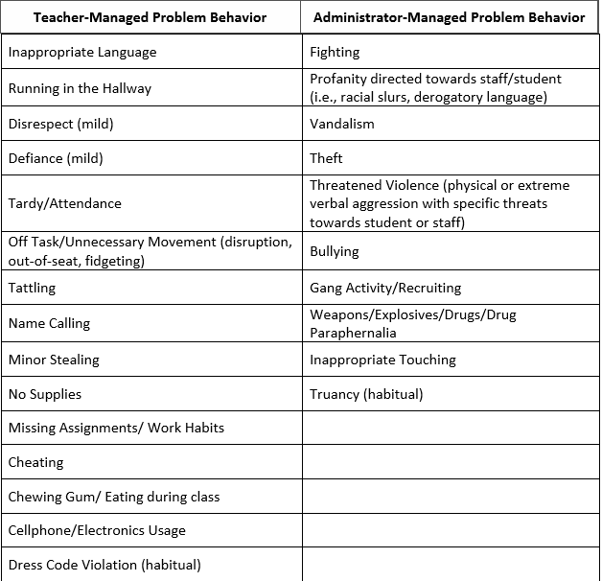

Slide 26
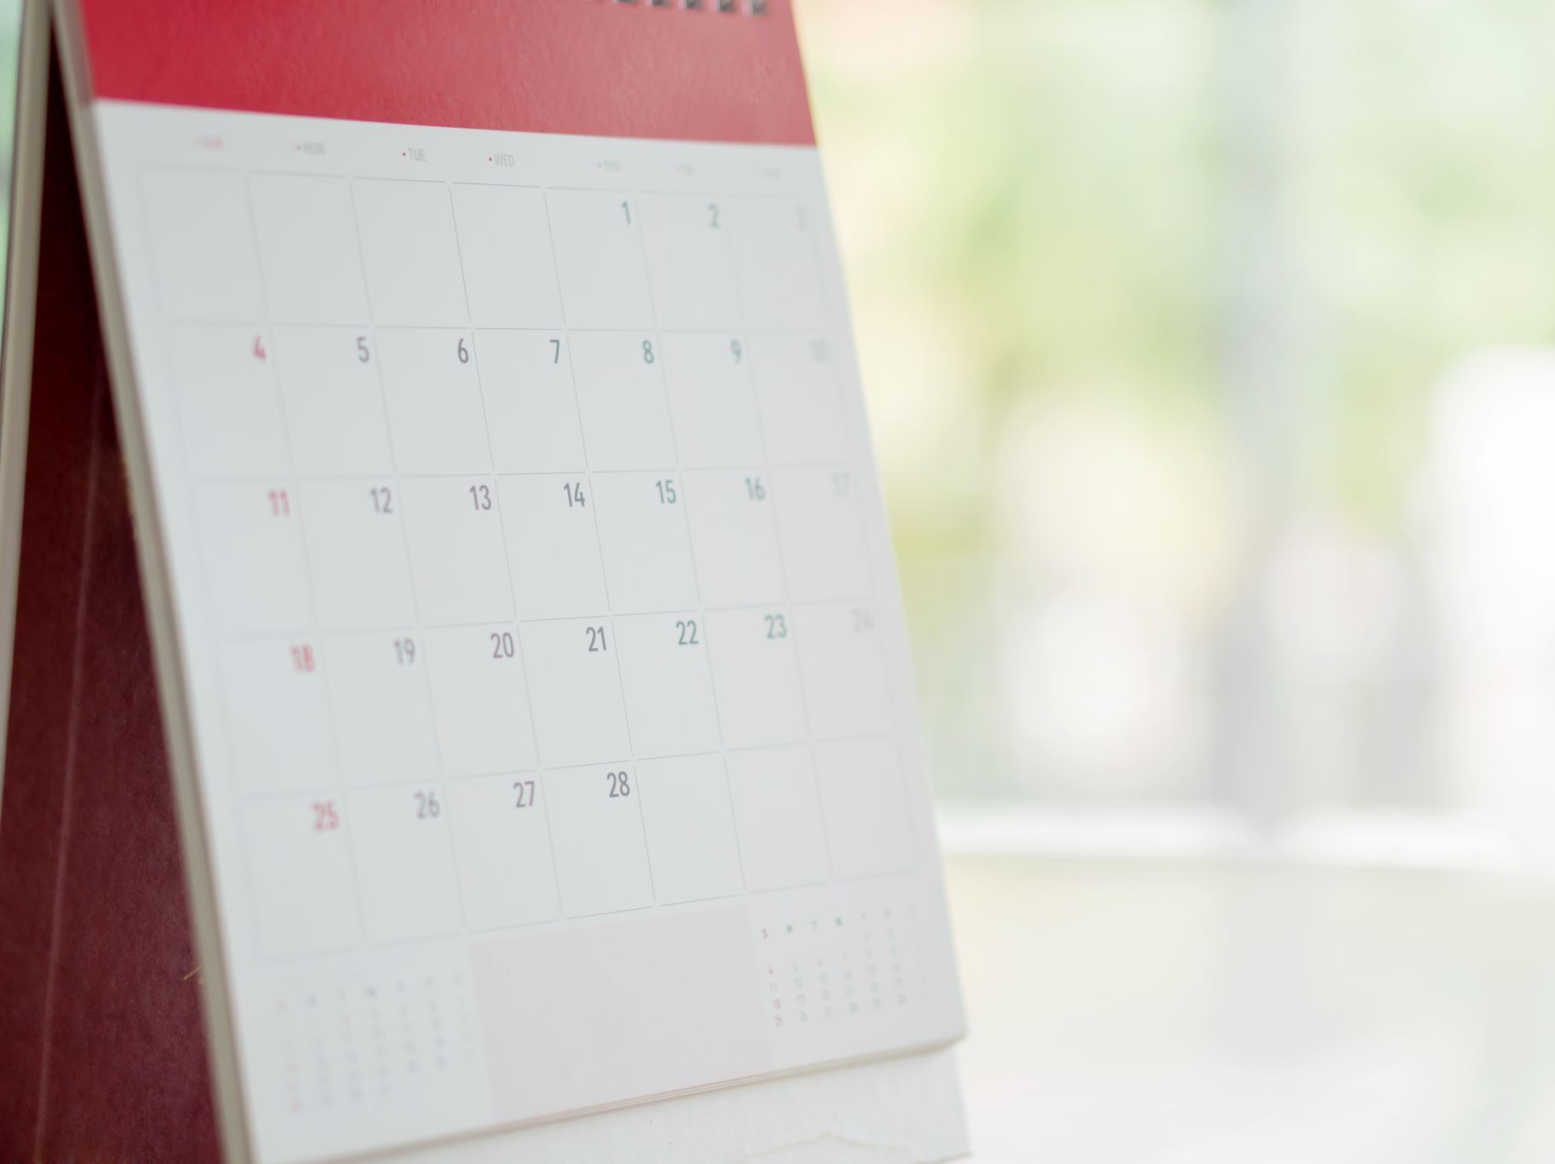

Daily Schedule
7:15-7:30 Homeroom announcements & attendance
7:30 -8:30 2nd Period/ Reinforcement
Restroom Break (all students follow restroom procedure)
8:35- 9:30 3rd Period / Planning (MAPS)
9:35-10:35 4th Period/ 8th Grade Science
10:40-12:05 5th Period / 8th Grade Science
11:00-11:25 Lunch/Restroom Break
12:10 - 1:10 6th Period/ 8th Grade Science
1:15-2:05 7th Period/ 8th Grade Science
2:10 Homeroom/Afternoon Announcements/Dismissal

Slide 27
Morning Announcements
Stop and be very quiet when morning announcements begin.
Stand and say the Pledge of Allegiance or stand and remain silent.
Stand quietly during Moment of Silence.
Next, we will say the “Daily Affirmation” together.
When told, be seated and quietly listen to morning announcements.
When morning announcements are over, continue with morning work and wait for instruction.

Slide 28
The Pledge of Allegiance
"I pledge allegiance to the Flag of the United States of America, and to the Republic for which it stands, one Nation under God, indivisible, with liberty and justice for all."

Slide 29


Slide 30

HAWK SQUAWK
CURRICULUM
The purpose of this curriculum is to start each instructional day on a positive note. Students and teachers will have an opportunity to reinforce positive thoughts about day-to-day living. The monthly themes coincide with SCS Character Education Focus for the month. The activity takes place every morning at the beginning of homeroom classes. The activities should last 10 minutes.

Slide 31
6th Grade Warm-up
Wednesday, August 11, 2021
Quick Write: Think about if you were a teacher… You would be in charge of making sure everyone in the classroom was safe and was learning. Write down three rules (not including the ones you see on the wall) that you would have in your classroom AND provide an explanation for why that rule is an important rule to have.
When you finish your quick right, open your middle school success booklet to page 6. Complete pages 6-9.

Slide 32
Today’s Agenda:
August 11, 2021
Welcome/Introductions/Share Quick Writes
First Day of School-Wide Transition
  Briefly answer questions about schedules
Classroom Rules and Procedures
Miscellaneous Information
Dismissal

Slide 33
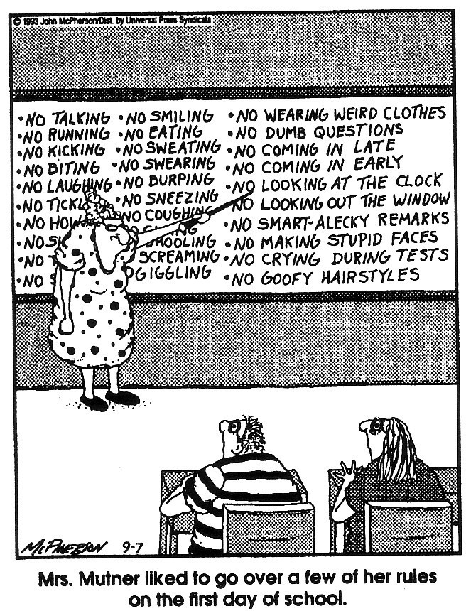
6th Grade Classroom Rules and Procedures

Slide 34
6th Grade Classroom Rules
1.
Be in your assigned seat, working on your do-now, until the timer goes off.
2.
Bring all of your materials to class.
3.
Treat each person in the classroom with dignity and respect.
4.
Remember to follow all directions the FIRST time that they are given.
5.
Remember to follow all the expectations and procedures in the Shelby County School System and at Highland Oaks Middle School.

Slide 35
ENTERING THE CLASSROOM
Students should enter the classroom, walking quickly and quietly.
Once seated, all materials and other belongings should be under the desk.
They should immediately begin their do-now and prepare to discuss with the whole class.

Slide 36
Teacher’s Corner
This area is off limits to students
Please refrain from being in the teacher’s corner
Consequences will follow disobedience

Slide 37
Class Interruptions
If you have a comment or question, please raise your hand.
Please do not talk and disrupt class with outbursts and persistent movements around the classroom

Slide 38


Moving Around in the Classroom
Unless you have permission, stay in your assigned seat.

Slide 39
Pencil Sharpening and Trash Procedure
Pencil Sharpening
Students are to sharpen pencils when they first enter the classroom, at least two pencils.
If your lead breaks, simply raise your pencil in the air and I will bring a replacement.
Trash
Trash will be thrown away when you are dismissed from class.
No paper should be on the floor.

Slide 40
Intercom Call
If the intercom tone sounds, you are to become absolutely quiet and remain that way.
ONLY THE TEACHER answers the intercom. Do not answer the intercom unless there is an emergency.
If the teacher is in the hallway, one student may step into the hallway to let the teacher know that the office is calling.

Slide 41


Housekeeping Procedures
Jackets
Keeping Up With Your Grades
You may wear a light jacket or sweater in the classroom.
All jackets must meet the Shelby County dress code.
All jackets must be worn correctly or placed on the back of your chair.
All grades can be found on Power School.
All students and parents need to be aware on how access Power School.

Slide 42

Housekeeping Procedures
Visitors
Substitute Teacher
This is the time that you should be on your best behavior. Displaying inappropriate behavior when a substitute teacher is present will result in the necessary discplinary actions.
When a visitor comes to the room you should continue working unless otherwise instructed.
Remain in your seat with NO talking.

Slide 43

HOUSEKEEPING PROCEDURES
Gum/Food/Candy
Students are not allowed to chew gum in school.
No food in the classroom unless during a classroom party or special treat.

Slide 44
Returning Absent Students
Please make sure you turn in sick notes to your homeroom teacher.
It is your responsibility to find out what you missed when you were absent.
If you missed an assessment come and please see teacher.
You have 2 days to complete missing assignments and turn them in.

Slide 45

Bullying
Bullying is NOT okay and it WILL NOT be tolerated at this school.
Your behavior will be documented and handled appropriately.
NO CHECKING.
NO TEASING.
NO TELLING OTHERS TO SHUT UP.
NO INAPPRORIATE COMMENTS OR BEHAVIOR.
KEEP YOUR HANDS TO YOURSELF AT ALL TIMES.
There are no exceptions.

Slide 46
Guidance and Counseling
Guidance counselors are available to help you with personal issues both in an out of school.
The counselor can help you to understand these situations and how to cope with them.
Your school counselors are Mrs. Stewart and Dr. Rumph.
If you need to meet with the,, let your teacher know, and they will reach out the respective counselor.
You will not be allowed to just go the guidance complex.

Slide 47
Medicine at School
The school does not keep and will not dispense any non-prescription medicines.
The school nurse will dispense medication to students only if prescribed by a physician and the school nurse has written permission from the parent. The medication must be in a prescription container that includes the physician’s directions for dispensing the medication.
Students are not permitted to keep any over-the-counter medicine including cough drops on them or in their lockers.
Consequences will follow if any type of medication is on your person without written permission from the school nurse.

Slide 48

Hall Passes
If you are alone, you must have a HOM approved hall pass.
If you are caught in the hallway without a hall pass, there will be consequences.

Slide 49

School Device Usage
Your device IS school property and should be treated with care.
You should only use school approved websites and/or apps.
Friendly Reminder: NOTHING IS PRIVATE!!!

Slide 50

6th Grade Supply List

Slide 51
Academic Integrity
(Honesty in Learning Policy):
Students are expected to maintain academic integrity. There should never be any plagiarism, cheating, or any other type of academic dishonesty. All potential cases of academic dishonesty will be settled by notifying the parents of all students involved, and the student(s) will be given a zero for the assignment. There are no exceptions.

Slide 52
PowerSchool
Power School will display assignments, due dates and grades.
You will be able to access this system on-line.
All students and parents should have information on how to access your account.

Slide 53
Grading Scale
A 93-100
B 85-92
C 75-84
D 70-74
F Below 70
A copy of the report card will be sent home at the end of each grading period (9 weeks). Parents will be notified, in advance, of the dates report cards will be sent home. Also, a progress report will be sent out at the 4 1/2 week mark, showing student progress.

Slide 54
Let’s get Back to the Basics!!!
Welcome to
6th Grade at Highland Oaks!
We are going to have a great year!

