Slide 1
Week 1 Social Studies… Why Study History?
Monday

Slide 2
ClassKick: go to Classkick.com
2nd Period | 446 8UP
3rd Period | 6AL GJS
5th Period | W35 VDR
7th Period | X7R N3V

Slide 3
BC/BCE AD/Ce circa (c. or ca) nomadic hunter-gatherer societies Agricultural Revolution barter economy domestication settlement surplus labor specialization
Social Studies Week 1 Vocabulary!

Slide 4
Warm-up:
In your Social Studies composition book, Come up with answers to the following questions:
In your own words, WHAT is the definition of history?
WHY do we study history?
WHO do we/should we study in history?
Is history unchanging? Once something is written, does it or can it change?

Slide 5
What is History?
A chronological record of significant events (as affecting a nation or institution) often including an explanation of their causes
A study of the events of the past, how and why they happened, as well as what happened as a result
A branch of knowledge that records and explains past events
Which definition is your favorite?
Which one do you think is the most accurate?

Slide 6
WHY study history?
Why do you think we should study history?
Seriously…. Why care at all???
How do a bunch of dead, old people help us in our lives?

Slide 7
Why Study History?
A short clip giving one take on the question:
https://www.youtube.com/watch?v=vgmNkYUL_Cw

Slide 8
WHY study history?
Why do you think we should study history?
“Those who are ignorant of the mistakes of the past are doomed to repeat them.”
Why not also study the SUCCESSES of the past and learn from them?
Do we need to know where we are from to help us figure out where we are going?
And, it’s FUN!

Slide 9
Okay, so how does a Historian do research and find “the truth?”
There are many pieces of evidence used to help Historians…

Slide 10
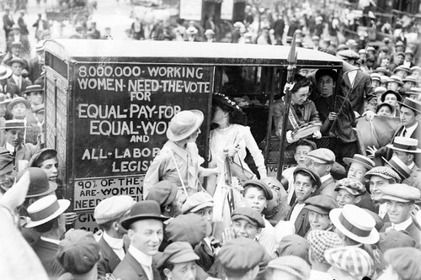
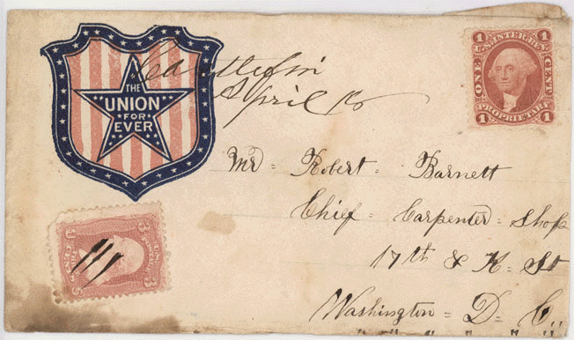
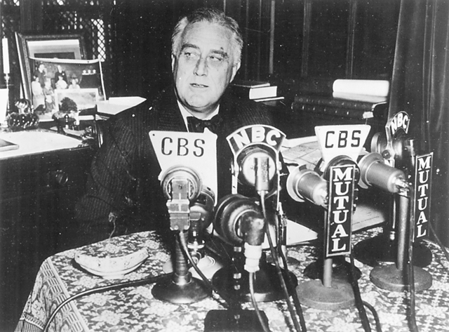
How do we know what we know about history when we were not there?
Written record – Letters, diaries, newspapers, books…
Oral record – Stories, music, speeches…
Visual record – Photographs, artwork, TV…
Artifacts – Things left behind (buildings, clothing, pottery…)

Slide 11
The written record

Slide 12
The Written Record
When studying history, we use PRIMARY SOURCES and SECONDARY SOURCES.
So… what are they? What do you think they are?
What is a source?
Why do we use sources?

Slide 13
Primary sources
A primary source is a document or physical object which was written or created during the time under study. These sources were present during an experience or time period and offer an inside view of a particular event.
Information from http://www.princeton.edu/~refdesk/primary2.html

Slide 14
Types of primary sources
Some types of primary sources include:
ORIGINAL DOCUMENTS (excerpts or translations acceptable): Diaries, speeches, manuscripts, letters, interviews, news film footage, autobiographies, official records
CREATIVE WORKS: Poetry, drama, novels, music, art
RELICS OR ARTIFACTS: Pottery, furniture, clothing, buildings

Slide 15
Examples of primary sources
Diary of Anne Frank - Experiences of a Jewish family during WWII
The Constitution of Canada - Canadian History
A journal article reporting NEW research or findings
Weavings and pottery - Native American history
Plato's Republic - Women in Ancient Greece
Can you think of any other primary sources?

Slide 16
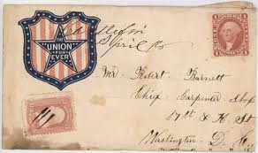
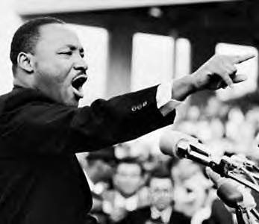
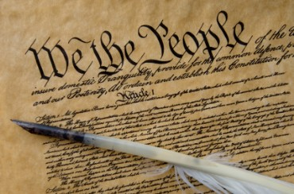
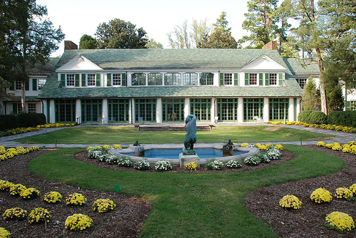
Primary sources

Slide 17
Secondary sources
A secondary source interprets and analyzes primary sources. These sources are one or more steps removed from the event. Secondary sources may have pictures, quotes or graphics of primary sources in them. Some types of secondary sources include:
PUBLICATIONS: Textbooks, magazine articles, histories, criticisms, commentaries, encyclopedias
Information from http://www.princeton.edu/~refdesk/primary2.html

Slide 18
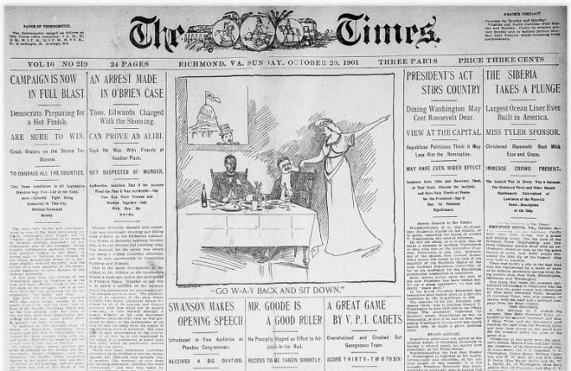
Examples of secondary sources
A journal/magazine article which interprets or reviews previous findings
A history textbook
A book about the effects of WWI
Can you think of any other secondary sources?

Slide 19
For sources, always ask yourself
What is the source?
When and where was it produced?
Who created it?
For whom was it created?
What was the creator’s intent?

Slide 20
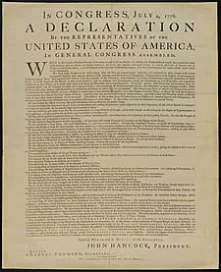
Primary vs. secondary sources
In groups of 3-4, discuss this question and come to an agreement on the question. Develop an argument supporting your response, and be prepared to share your answer with the class.
Is one type of source more valuable than the other? Why/why not?
VS.

Slide 21
The oral record

Slide 22
Oral record
The American Indians did not have a written record until the 1800s. How do we know about their lives and history before then? How did THEY know?
Are oral histories reliable? Why or why not?

Slide 23
Oral history today
Oral history very popular today, and many people are working to record people’s stories to preserve them for future generations.
Ellis Island Oral History - http://teacher.scholastic.com/activities/immigration/tour/stop2.htm
StoryCorps – A project from NPR designed to capture the stories of everyday Americans (not just politicians and other famous figures). http://storycorps.org/listen/

Slide 24
The visual record

Slide 25
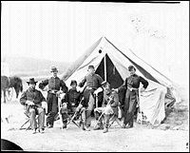
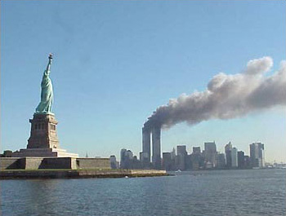
Visual sources
How can the visual record be helpful to us when we try to understand the past?
What types of visual sources can we use?
Photographs
Artwork
Video
Six officers of the 17th New York Battery – Gettyrsburg, PA June 1863
http://memory.loc.gov/ammem/cwphtml/tl1863.html

Slide 26
Visual Record

Slide 27
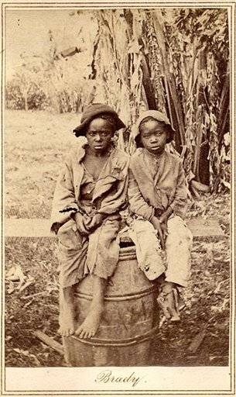
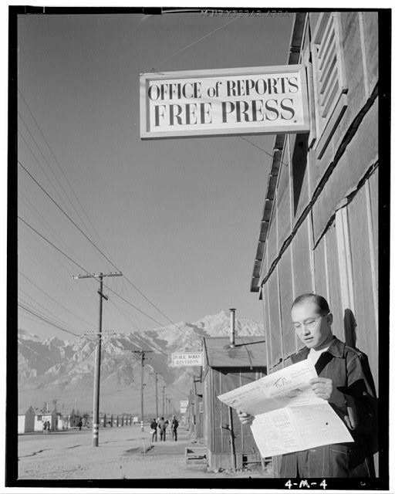
Visual Record

Slide 28
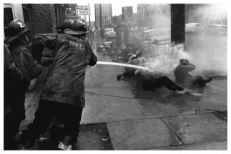
Visual record

Slide 29
The Artifact Record

Slide 30
Artifact record
What is an artifact? Put it in your own words.
For each of the following pictures, in your composition book, tell what you can conclude about the time in the past that is shown.

Slide 31
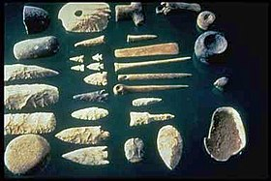
A collection of stone tools…

Slide 32
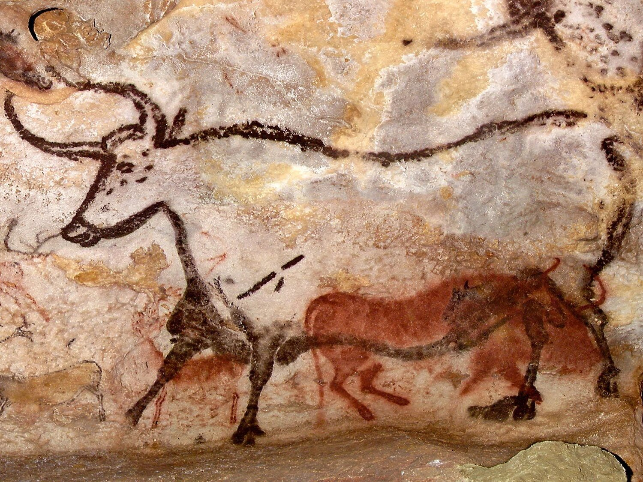
Prehistoric cave art…

Slide 33
5 things you did yesterday
Did you leave a record of any of these?
Written, oral, visual, and/or artifact
How would future HISTORIANS know what you did?

Slide 34
Exit Ticket 3, 2, 1
What do you think are the 3 most important things to use in studying the past?
What are 2 warnings you need to give someone who is trying to “figure out” the past?
Answer this 1 important question: How do we know what we know about the past when we were not there?

Slide 35
Week 1 Social Studies… How do we “measure” History?
Tuesday

Slide 36
BC/BCE AD/Ce circa (c. or ca) nomadic hunter-gatherer societies Agricultural Revolution barter economy domestication settlement surplus labor specialization
Social Studies Week 1 Vocabulary!

Slide 37
Standards:
6.01 Identify the meaning of time designations and abbreviations used by historians, including: BC/BCE, AD/CE, Circa (c. or ca), decades, centuries.
6.02 Describe the characteristics of the nomadic hunter-gatherer societies, including their use of: Basic hunting weapons, Fire, Shelter, Tools.

Slide 39
A large part of the world’s population uses the Gregorian or Christian calendar that measures time from the birth of Jesus.
The year of Jesus' birth and the years after are
recorded as AD, which stands for anno domini.
This is Latin and means 'in the year of our Lord.'
This year it is 2014 AD, but we don't usually write the AD anymore.
The time before Jesus was born is known as BC, which stands for before Christ.
Jesus is born
2012
BC
AD 1
AD

Slide 40
What about the people who are NOT Christian?
The year of Jesus' birth and the years after are
recorded as CE, which stands for the Common Era.
This is done to avoid the Christian references.
This year it is 2021 CE, but we don't usually write the CE anymore.
The time before Jesus was born is known as BCE, which stands for Before the Common Era. Again, this is done to avoid the Christian reference.
Jesus is born
2012
BCE
CE 1
CE

Slide 41
What does it all mean?
B.C. = Before Christ
A.D. = Anno Domini = Latin for "Year of our Lord"
B.C.E = Before Common Era
C.E. Common Era
Although these terms refer to the same years on a timeline, they cannot be intermixed.
B.C. and A.D. can only be used together.
B.C.E. and C.E. can only be used together.
B.C. or B.C.E
A.D. or C.E.

Slide 42
A Brain teaser…
How can someone born in 2010 be 10years old in 2000?!?!?

Slide 43
A Brain teaser…
How can someone born in 2010 be 10years old in 2000?!?!?
They were born in 2010 BC or BCE

Slide 44
B.C. and B.C.E dates get smaller as they get closer to the present. It is like a countdown.
Example: If you were born in 270 B.C.E.
and if you lived 70 years,
you would have died in 200 B.C.E.
(not 340 B.C.E).

Slide 45
Digging Up the Past
Decade: A group of 10 years
Century: A group of 100 years
Circa: About or Approximately

Slide 46
Timelines
A timeline is another way to track the passage of time.
Timelines show the order of events within a period of time.
They also show the amount of time between events.
Most time lines are divided into even sections of time.
Events are placed on a time line at the date when the event occurred.

Slide 47
Timelines
Usually, the dates on a time line are evenly spaced. Sometimes, however, a time line covers events over too many years to show on one page. In this case, a slanted or jagged line might be placed on the time line. This shows that a certain period of time is omitted from the time line.
Time lines help historians make sense of the flow of events. A time line can be a single line, or it can be two or more lines stacked on top of each other. Stacked time lines are called multilevel time lines.

Slide 48
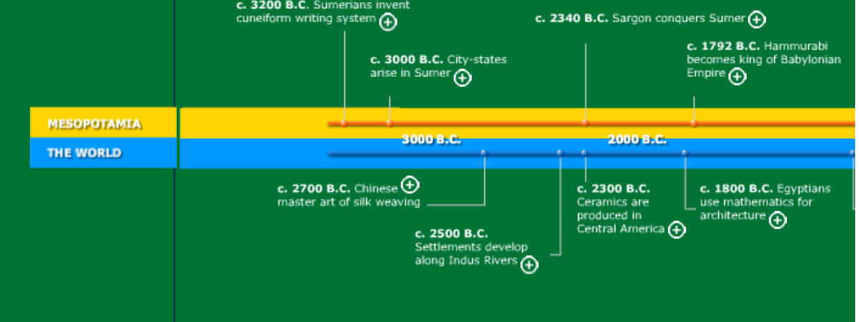
Example Timeline

Slide 49
Dates work backwards before Jesus (BC or BCE).
So 100 BC is 90 years before 10 BC!
Remember:
Can you sort these dates in order on the timeline?
2012 AD
917 AD
1467 BC
1964 AD
1066 AD
1350 BC
32 BC
2012 BC
1

Slide 50
Arrange the following dates in the correct order on the timeline.
2400 B. C. - Pictographic signs become cuneiform
2100 B. C. - Ur becomes the capital the new empire
1200 B. C. - Assyrians conquer much of Mesopotamia
2700 B.C. - Epic of Gilgamesh Written
75 A. D. - Last dateable cuneiform tablet
1800 B. C. - Hammurabi unites much of Mesopotamia
2300 B.C. - Sumerian cities united by King Sargon
1 A.D.
3200 B. C. - Pictographic record keeping is used
Dates by the British Museum, online http://www.mesopotamia.co.uk/time/explore/main_mes.html#3000B.C.

Slide 51
3200 B. C. - Pictographic record keeping is used
Check to see if your dates are in the correct chronological order on the timeline.
2700 B.C. - Epic of Gilgamesh Written
2400 B. C. - Pictographic signs become cuneiform
2300 B.C. - Sumerian cities united by King Sargon
2100 B. C. - Ur becomes the capital the new empire
1800 B. C. - Hammurabi unites much of Mesopotamia
1200 B. C. - Assyrians conquer much of Mesopotamia
1 A. D.
75 A. D. - Last dateable cuneiform tablet
Dates by the British Museum, online http://www.mesopotamia.co.uk/time/explore/main_mes.html#3000B.C.

Slide 52
Arrange the following dates in the correct order on the timeline.
2700 B.C.E
First stone
pyramid built
1922 C.E.
Howard Carter
discovered
tomb of King Tut
1799 C.E.
Rosetta Stone
found
2600 B.C.E.
Pyramid of
Giza built
642 C.E.
Egypt conquered
by Arabs from
the east.
969 C.E.
City of Cairo
founded
332 B.C.E.
Alexander the Great
conquered Egypt
1500 B.C.E
Hatshepsut became
pharaoh
3500 B.C.E.
People settled in
the Nile Valley.
1 C.E.

Slide 53
The following dates are in the correct chronological order on the timeline.
1922 C.E.
Howard Carter
discovered
tomb of King Tut
3500 B.C.E.
People settled in
the Nile Valley.
2600 B.C.E.
Pyramid of
Giza built
332 B.C.E.
Alexander the Great
conquered Egypt
969 C.E.
City of Cairo
founded
2700 B.C.E
First stone
pyramid built
1500 B.C.E
Hatshepsut
became
pharaoh
1 C.E.
642 C.E.
Egypt conquered
by Arabs from
the east.
1799 C.E.
Rosetta Stone
found

Slide 54
Do Now/Warmup 8/25
In your composition books, draw a timeline of your day, be sure to include all the major events of the day and use spacing to show the length of time between these events.

Slide 55
Week 1 Social Studies… What happened before “History?”
Wednesday

Slide 56
BC/BCE AD/Ce circa (c. or ca) nomadic hunter-gatherer societies Agricultural Revolution barter economy domestication settlement surplus labor specialization
Social Studies Week 1 Vocabulary!

Slide 57
Standards:
6.01 Identify the meaning of time designations and abbreviations used by historians, including: BC/BCE, AD/CE, Circa (c. or ca), decades, centuries.
6.02 Describe the characteristics of the nomadic hunter-gatherer societies, including their use of: Basic hunting weapons, Fire, Shelter, Tools.

Slide 59
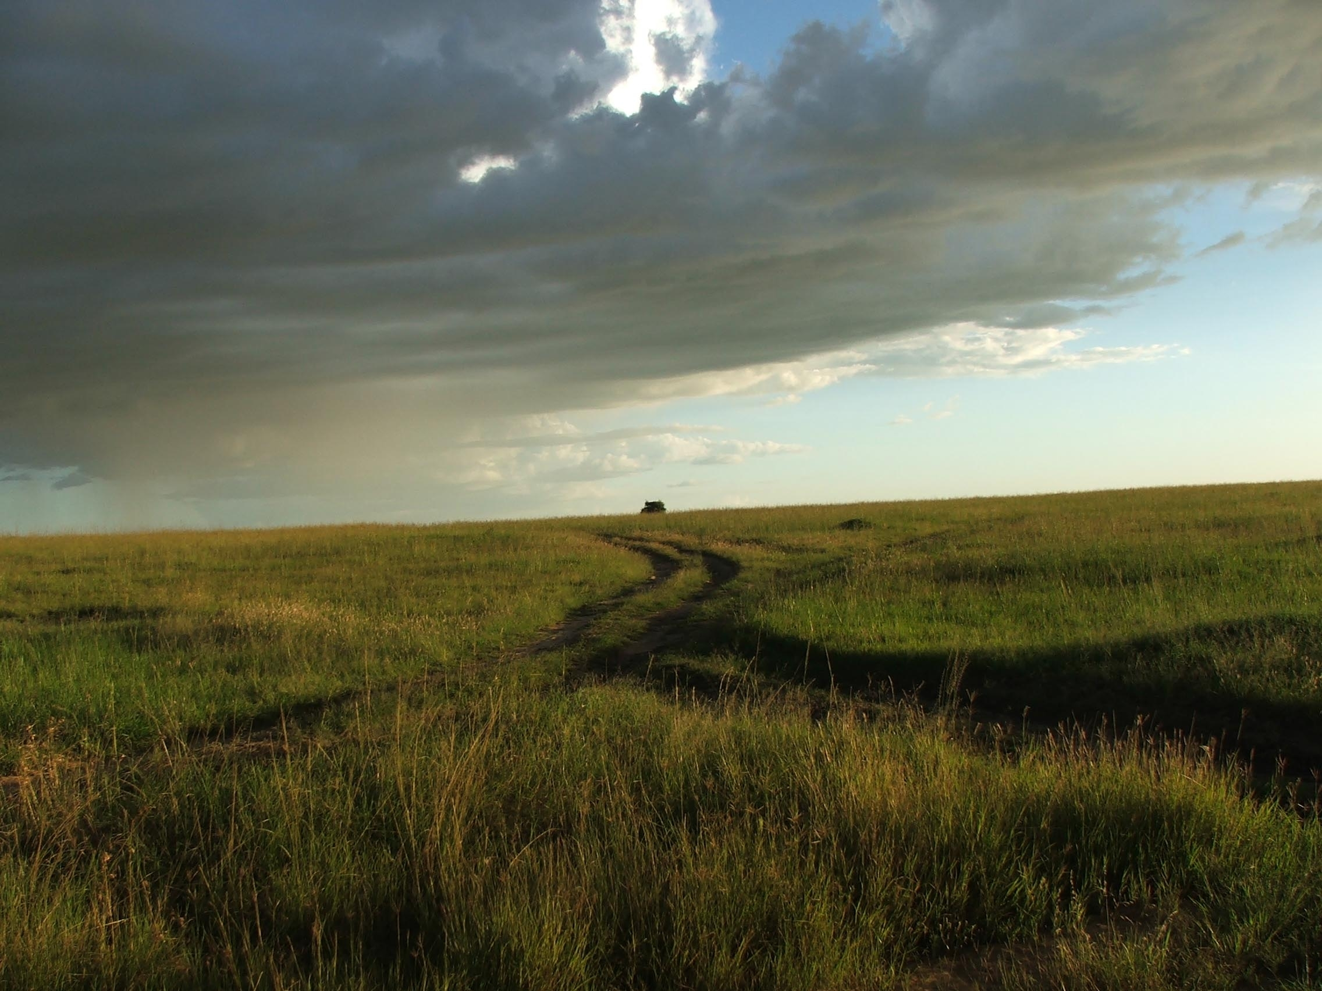
Early Humans
Copyright © Clara Kim 2007. All rights reserved.

Slide 60
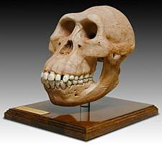
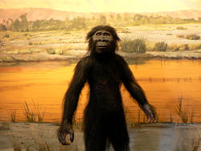
Australopithecines
1st to grow the opposable thumb
First humanlike creature to walk upright

Slide 61
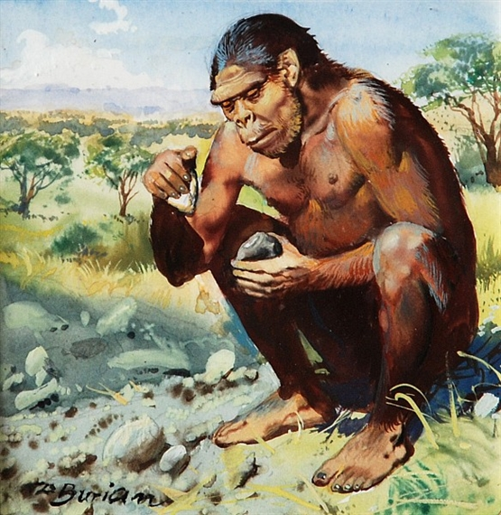
Homo Habilis “Man of Skill”
Traits
2.5-1.5 million BC
Achievements
Made tools from lava rock
Use tools to cut meat and crack bones

Slide 62
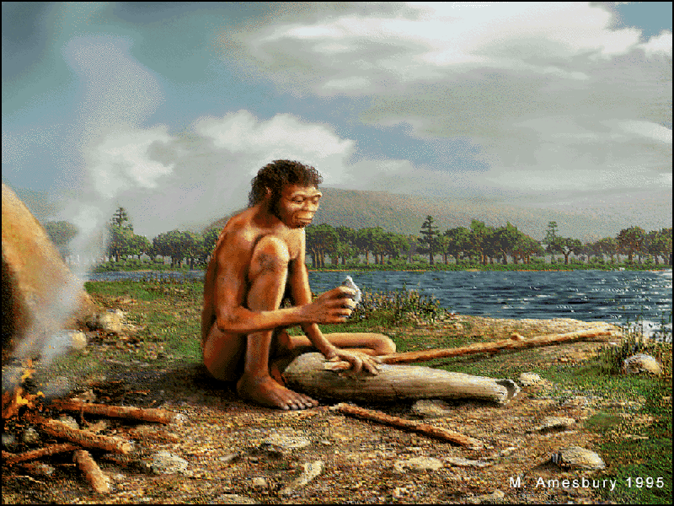
Homo Erectus “Upright Man”
Traits
1.6 - 30,000 million BC
More intelligent and adaptable
Achievements
Used intelligence to develop technology

Slide 63
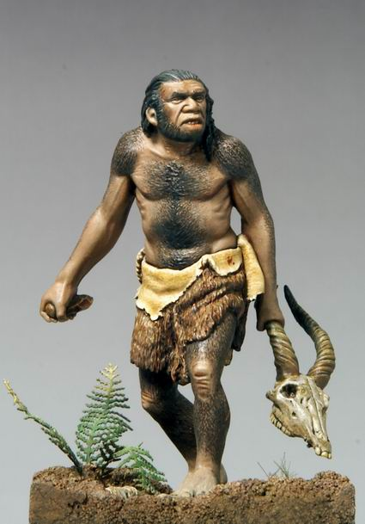
Neanderthal
Traits
200,000 – 30,000 BC
Powerfully built
Heavy slanted eyebrows
Achievements
First to have ritual burials
Tried to control and explain the world

Slide 64
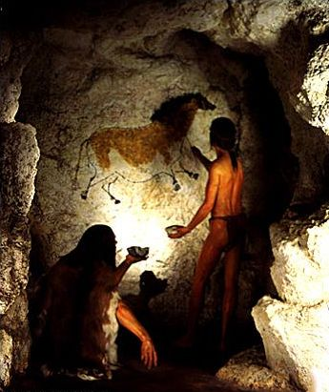
Cro Magnons
Traits
Identical skeleton to modern humans (Homo Sapien)
Achievements
Studied animals’ habits
Planned their hunts
Advanced skill in spoken language
Created art

Slide 65
How it all began…
Homo Sapiens (modern humans) appeared in Africa 100,000 to 400,000 years ago.
Then migrated to
Europe
Asia
Australia
The Americas

Slide 66
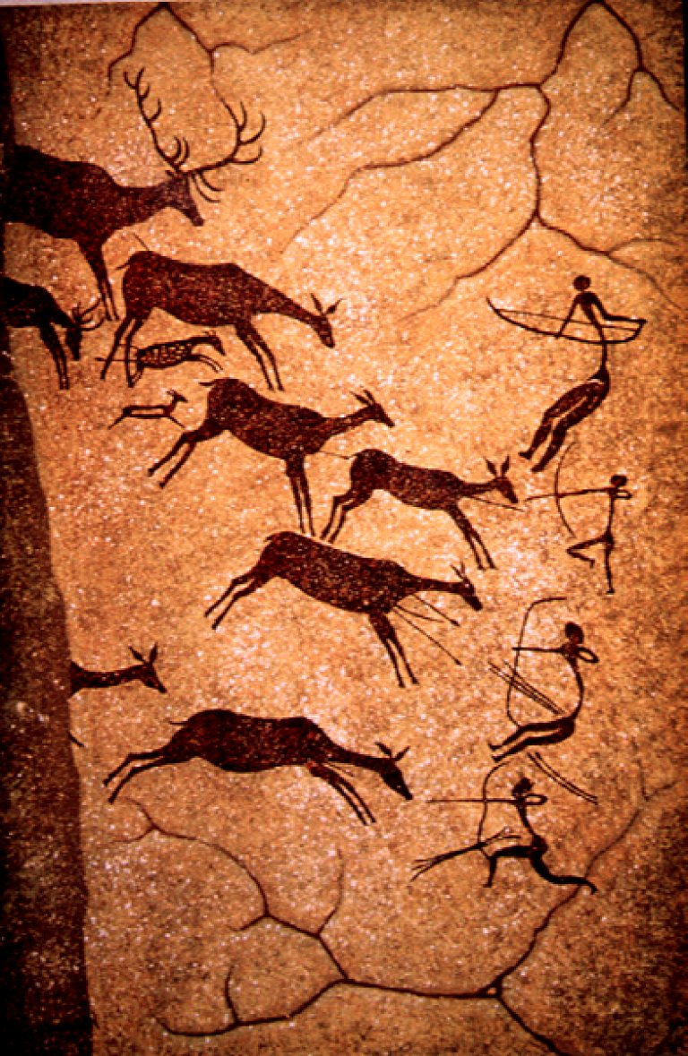
How did they find their food?
Early human societies met their needs by hunting animals and gathering other foods like edible plants.
These hunters and gatherers were also known as nomads.

Slide 67
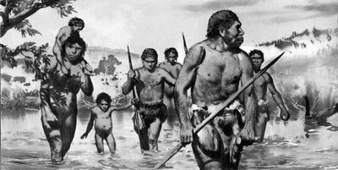
Nomads
Nomads: People who depend on wild plants and animals to survive. They followed where the food supply went and gathered seeds and nuts.

Slide 68
THE STONE AGE
STONE AGE:
DEFINITION: THE PERIOD OF PREHISTORY THAT
BEGINS WITH THE DEVELOPMENT OF
STONE TOOLS
THE STONE AGE CAN BE DIVIDED INTO TWO ERAS
1) PALEOLITHIC AGE
2) NEOLITHIC AGE

Slide 69
THE STONE AGe
PALEOLITHIC AGE:
DEFINITION: THE OLD STONE AGE
PALEO- OLD
LITHIC- STONE AGE
-IT LASTED FROM ABOUT 2.5 MILLION TO 8000 BCE (BEFORE COMMON ERA)
-ARRIVAL OF HOMINIDS ABOUT 1.6 MILLION YEARS AGO
DEFINITION: SPECIES OF CREATURES THAT WALK UPRIGHT

Slide 70
THE STONE AGE
A) EARLY HUMANS
- DEVELOPED TECHNOLOGY
DEFINITION: WAYS OF APPLYING KNOWLEDGE,TOOLS AND INVENTIONS TO MEET THEIR NEEDS.
ABOUT 40,000 YEARS AGO, A NEW GROUP OF PREHISTORIC HUMANS CALLED
CRO-MAGNONS APPEARED THEY…
-DEVELOPED MORE SPECIALIZED TOOLS AND SPOKEN LANGUAGE APPEARED IN ORDER TO HUNT EASIER.
-APPEARANCE OF CAVE DRAWINGS THAT DEPICTED THE EVENTS OF PREHISTORIC LIFE
- THESE DRAWINGS HAVE HELPED ANTHROPOLOGISTS LEARN MORE ABOUT PREHISTORIC LIFE

Slide 71
Week 1 Social Studies… What happened when people “settled down?”
Thursday

Slide 72
BC/BCE AD/Ce circa (c. or ca) nomadic hunter-gatherer societies Agricultural Revolution barter economy domestication settlement surplus labor specialization
Social Studies Week 1 Vocabulary!

Slide 73
Standards:
6.01 Identify the meaning of time designations and abbreviations used by historians, including: BC/BCE, AD/CE, Circa (c. or ca), decades, centuries.
6.02 Describe the characteristics of the nomadic hunter-gatherer societies, including their use of: Basic hunting weapons, Fire, Shelter, Tools.

Slide 75
THE STONE AGE
NEOLITHIC AGE
DEFINITION: THE NEW STONE AGE
NEO: NEW
LITHIC: STONE AGE
- IT BEGAN ABOUT 8000 BCE
- THE MOST SIGNIFICANT EVENT THAT TOOK PLACE DURING THIS ERA WAS THE NEOLITHIC REVOLUTION

Slide 76
NEOLITHIC REVOLUTION
NEOLITHIC REVOLUTION:
-CHANGE FROM BEING NOMADIC TO CREATING PERMANENT SETTLEMENTS.
-BEGAN TO DEVELOP NEW TECHNOLOGIES
AGRICULTURE AND DOMESTICATION
(AGRICULTURAL REVOLUTION)
AGRICULTURE – GROWING OF CROPS FOR FOOD
DOMESTICATION- BREEDING OF ANIMALS FOR FOOD SUCH AS CATTLE, GOATS, SHEEP AND PIGS

Slide 77
NEOLITHIC REVOLUTION
IMPACT OF THE NEOLITIC REVOLUTION:
THE SHIFT FROM FOOD GATHERING TO FOOD PRODUCTION WAS AN IMPORTANT ACHIEVEMENT IN THE EVOLUTION OF MAN.
(1) UNLIKE HUNTING AND GATHERING, AGRICULTURE AND DOMESTICATION PROVIDED A STEADY SOURCE OF FOOD.
(2) WITH A GREATER FOOD SUPPLY, POPULATION BEGAN TO INCREASE AND SPECIALIZED ROLES IN SOCIETY BEGAN TO APPEAR THAT WOULD LEAD TO THE DEVELOPMENT OF CIVILIZATIONS.

Slide 79
ADVANCEMENTS DURING THE NEOLITHIC AGE
ROLES IN SOCIETY
-PEOPLE SETTLED IN VARIOUS ROLES, SOCIAL CLASSES WITH VARYING WEALTH, POWER AND INFLUENCE BEGAN TO EMERGE. THIS BECAME KNOWN SPECIALIZATION.
DEFINITION: THE DEVELOPMENT OF SKILLS
IN A SPECIFIC KIND OF WORK
- AS POPULATIONS GREW, THESE EARLY SETTLEMENTS BEGAN TO EVOLVE INTO POWERFUL CIVILIZATIONS.

Slide 80
Advancements During the Neolithic Revolution
Economic Changes
-As civilizations began to appear, they developed traditional economies
Traditional Economy-
- Based on Agriculture and simple crafts
- Use of barter system (trade)

Slide 81
Compare and Contrast Chart
Paleolithic Age ( Old Stone Age)
Neolithic Age ( New Stone Age)
-Development
of
Technology
-Art
-Early Religion
-Advanced Stone Tools
-Created Permanent
Settlements
-Agriculture/
Domestication
Huts
Simple Stone Tools
Nomads
Hunting/Gathering
Caves
Similarities
Differences

Slide 82
Week 1 Social Studies… Quiz
Friday…

